Slide 1

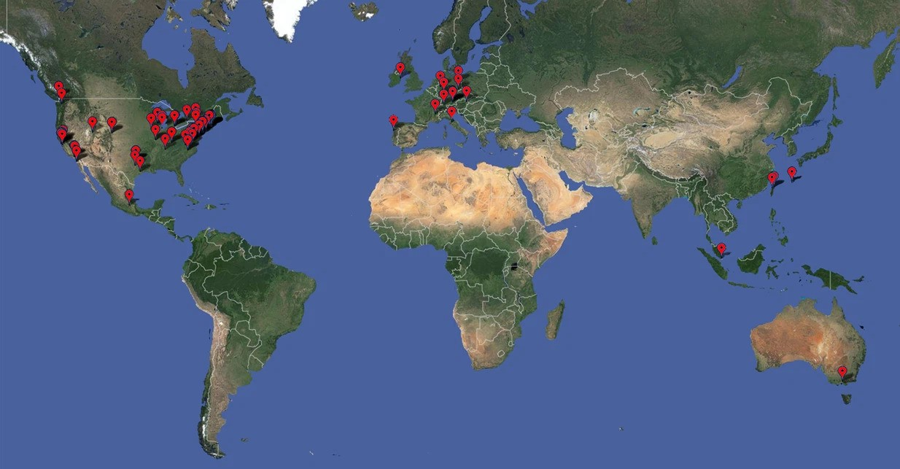
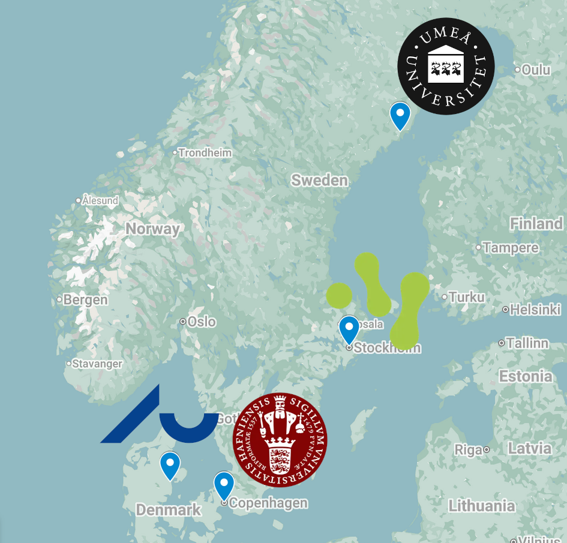
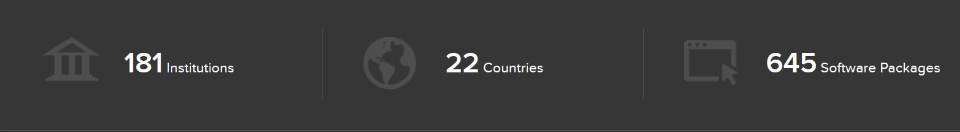


Cryo-EM Data at Scale:
How collaborative models arose around the world
Dr Keiran Rowell - Structural Biology Facility - UNSW - RSAA2025 - 18th Sept - Online/AUS
Cutting Edge: Collaboration gets the most out of software, eLife 2:e01456. (2013)
sbgrid.org
cryonet.nu

Slide 2
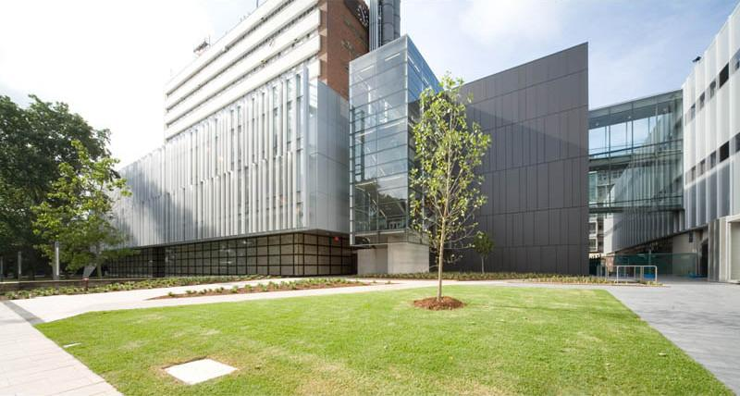

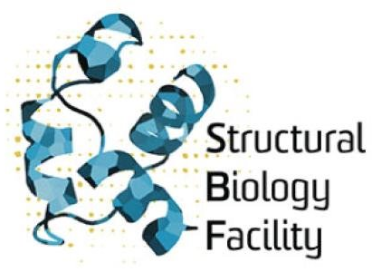

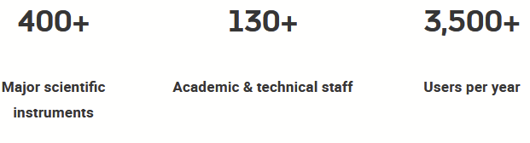

Sharing is caring
Mark Wainwright Analytical Centre (MWAC) | Facilities & Infrastructure - UNSW Research - Accessed: 20/07/2025
“The Mark Wainwright Analytical Centre (MWAC) is the largest shared facility in Australia.” [Emph. mine / PVC RI]

Slide 3
Systems administration & design process
Trust & Respect
Gained
Eroded
Demonstrations
Co-working
Translation
Mental models
Progress updates
Advocacy
Expertise
Collaboration with others
Valuing other technical fields
Learning their problems
Turning up
Planning
Resource hoarding
Outages
Dismissiveness
Jargon
Solving the wrong problems
Frustrations
Puritanism
Ego
Notes:
Save time, don’t walk through every point. Key point they’re not trained in computer science – used the the way domestic computing which is *very* different to shared HPC environments, something HPC people get used to.

Slide 4
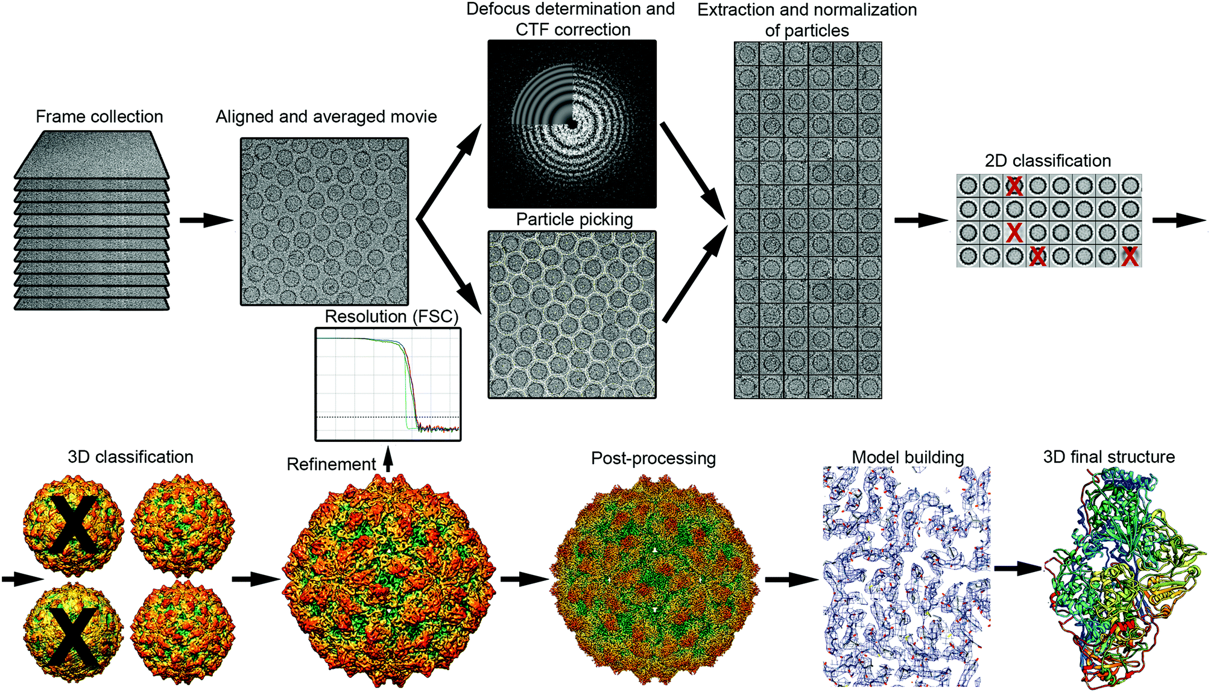
Raw data explosion
Structural nanotechnology: three-dimensional cryo-EM and its use in the development of nanoplatforms for in vitro catalysis Nanoscale, (2019), 11, 4130-4146
Compute needs
2-10 TB/day
10+ GbE
Months retention
Worker SSD
Low/no queue

Slide 5
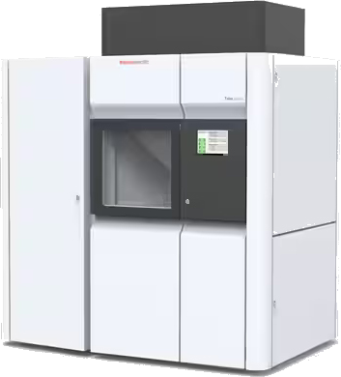
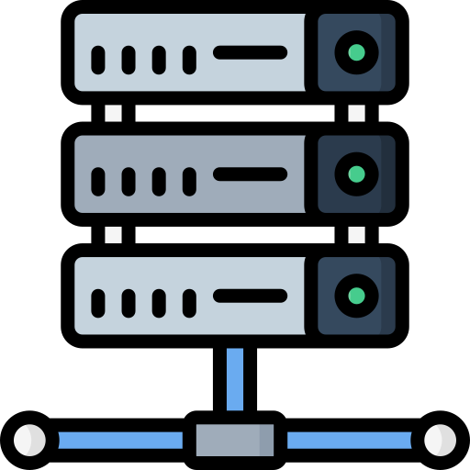


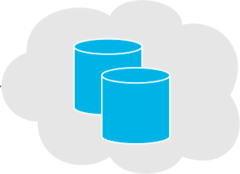
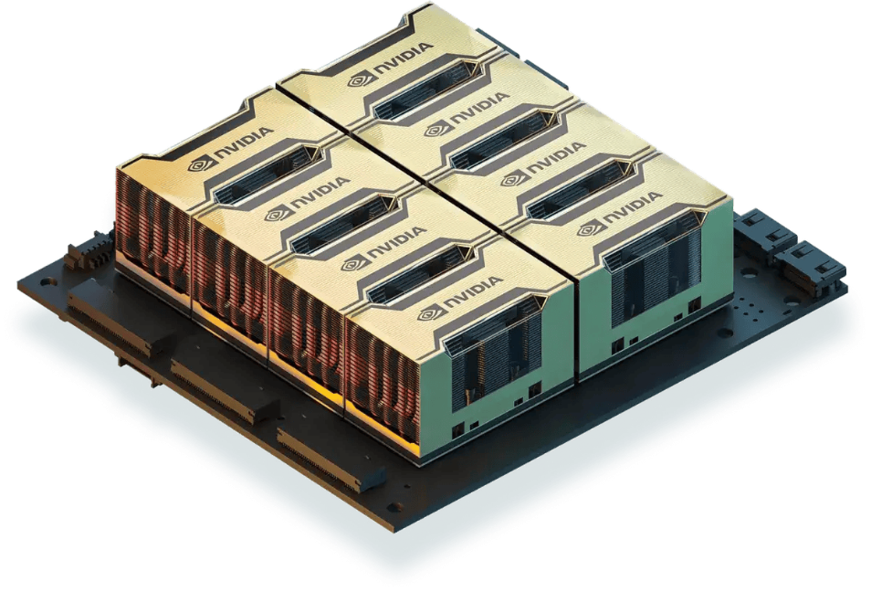

TFS Arctica​ Cryo-EM​
On-the-fly processing
Electron Microscopy Unit Staff QA, movie averaging, tomo., model building, etc.
5 TB
0.25–5 M particles
Job files cached on SSD
Direct detector pass-through storage​
Structural Biology Facility Users Single particle reconstruction, AlphaFold, etc.
IBM Elastic Storage System
10–20 TB
Total project files
DDN (old)
DDN (newer)
5–20 GB
Final map
cryosparc.analytical.unsw.edu.au
EMU ⟷ SBF pipeline in development ​- Orig. Credit: A/Dir. Dr Daniel Luque
Notes:
TB/s a day dat movement problem on slide. Networking 25Gib+ Start with 10 TB, whittle down onto the worker

Slide 6
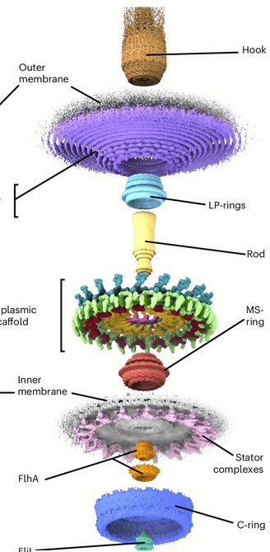
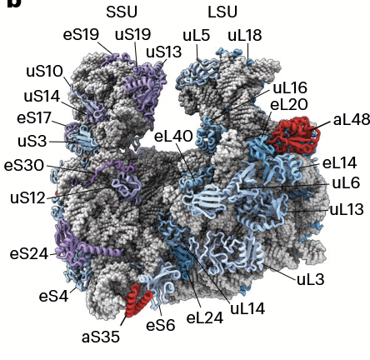
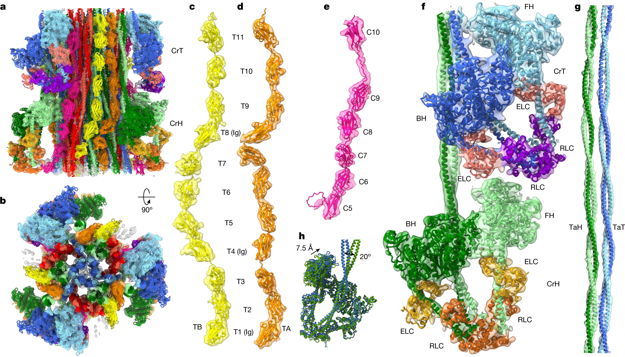
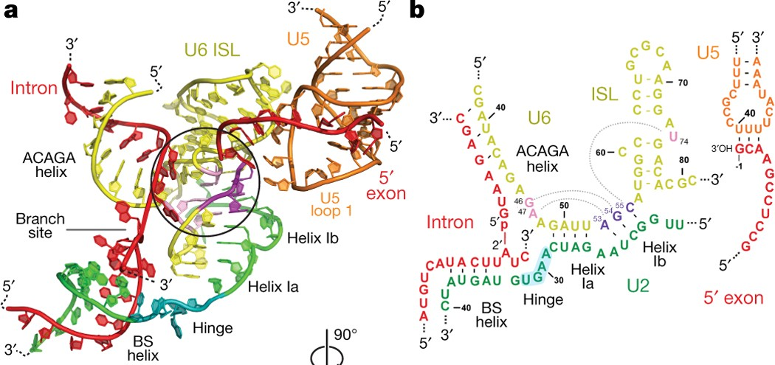
CryoEM is scientifically worth the pain
1. Cryo-EM structure of the human cardiac myosin filament, Nature, 623, 853–862 (2023)
2. Structure of an archaeal ribosome reveals a divergent active site and hibernation factor, Nature Micro., (2025)
3. In situ structure of a bacterial flagellar motor…, Nature Micro., (2025)
4. Spliceosome activated for step 2 of splicing, Nature, 542, 318–323 (2017)
1. The solved structure of titin, the longest human protein
2. The archeal ribosome with unique archeal proteins coloured red
4. The intricate RNA network in the human spliceosome which ‘cuts’ mRNA into different forms of a protein
3. The entire bacterial flagella motor at fractions of a nm resolution

Slide 7
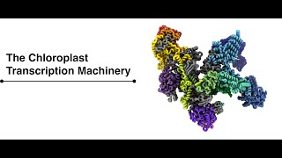
I mean really groundbreaking
Structure of the plant plastid-encoded RNA polymerase, Cell, Volume 187, Issue 5, p1145-1159.e21, February 29, 2024
“The Chloroplast Transcription Machinery” [video], Webster Lab, John Innes Centre for plant science
Notes:
Don’t let this play through, just a few 10s of seconds

Slide 8
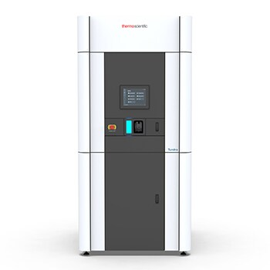
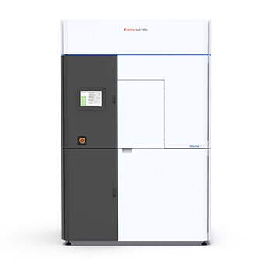
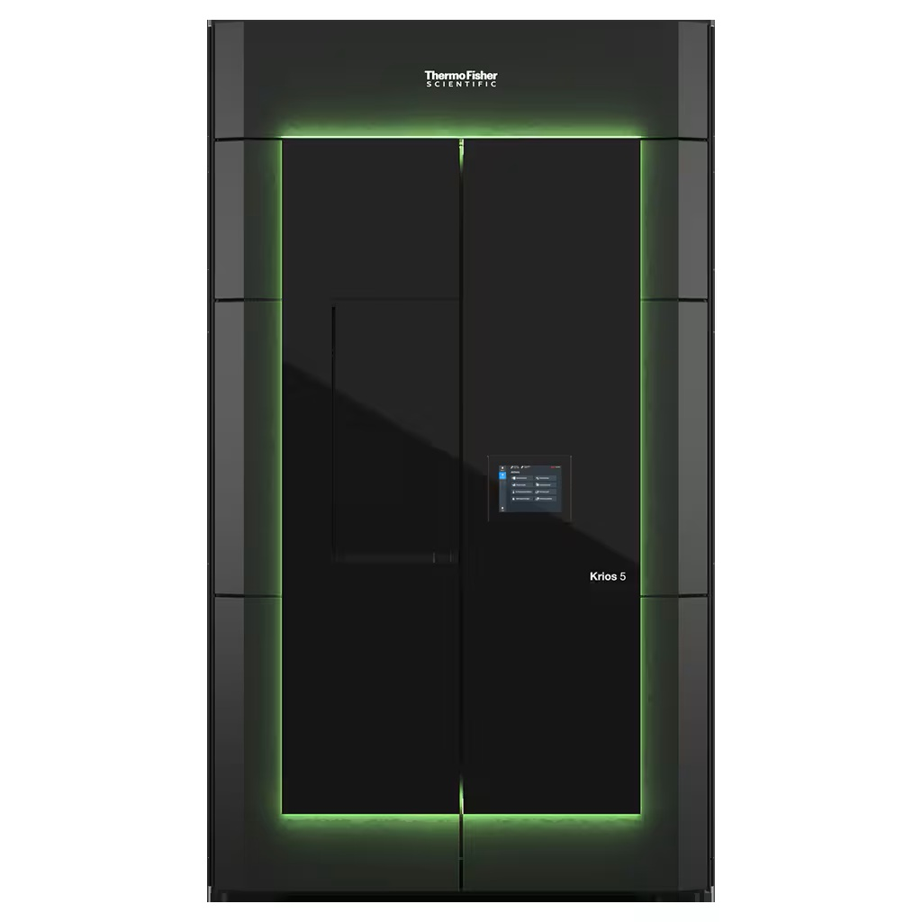

Electron microscopes are expensive
Cryo TEM | Cryo Transmission Electron Microscopes | Thermo Fisher Scientific - AU - Accessed: 20/07/2025
Tundra (~$1M)
Glacios 2 (~$3M)
Krios 5 (~$6M)

Slide 9
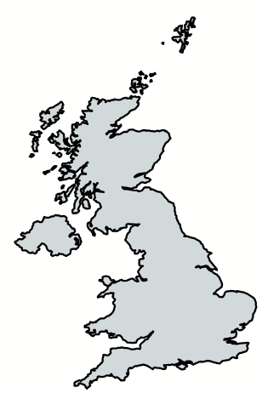
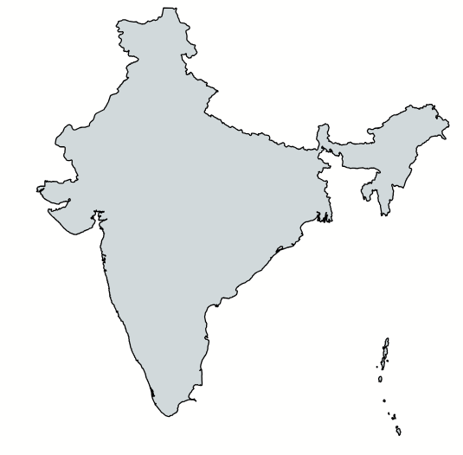
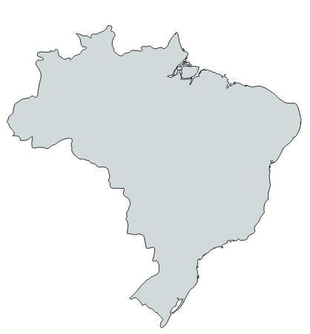
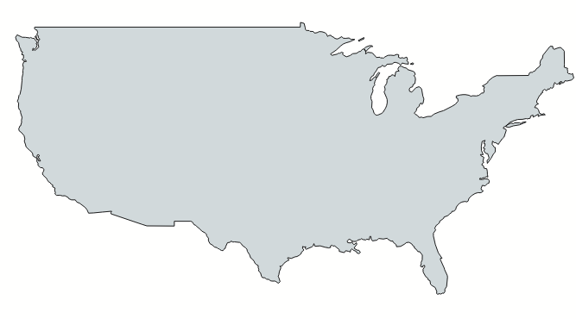
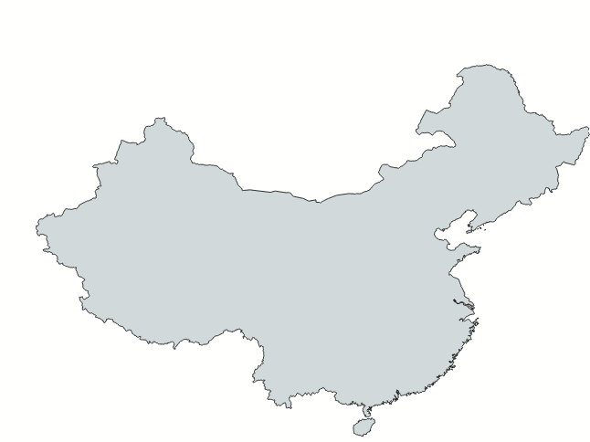
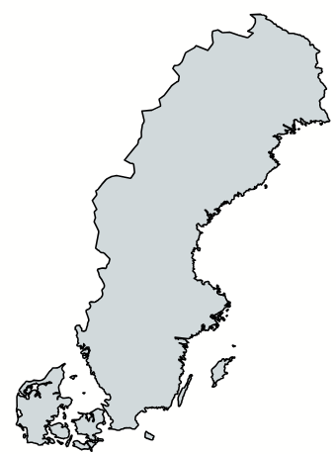
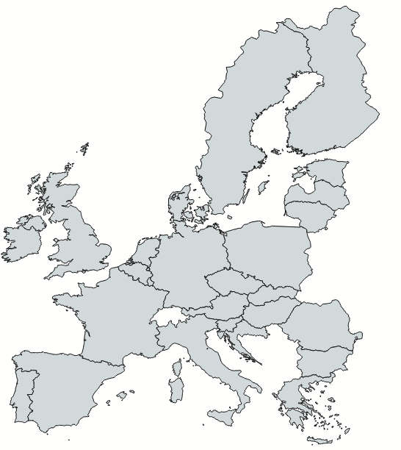
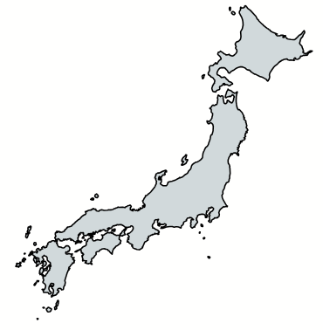
They’re organised I tell you!
CryoEM Service Centers, a working list, Pacific Northwest CryoEM Centre, 16th July (2021) - Updated: 05/07/2025
National Electron Cryo-Microscopy Facility (2017)
LNNano (2018)
electron Bio-Imaging Centre Diamond light source (2018)
SBGrid (2000)
PReSTO
(2013)
iNEXT-Discovery
(2020)
BINDS
CryoEM
network
(2018)
Beijing Frontier Research Centre
for Biological Structure (2007)
cryoNET (2018)

Slide 10
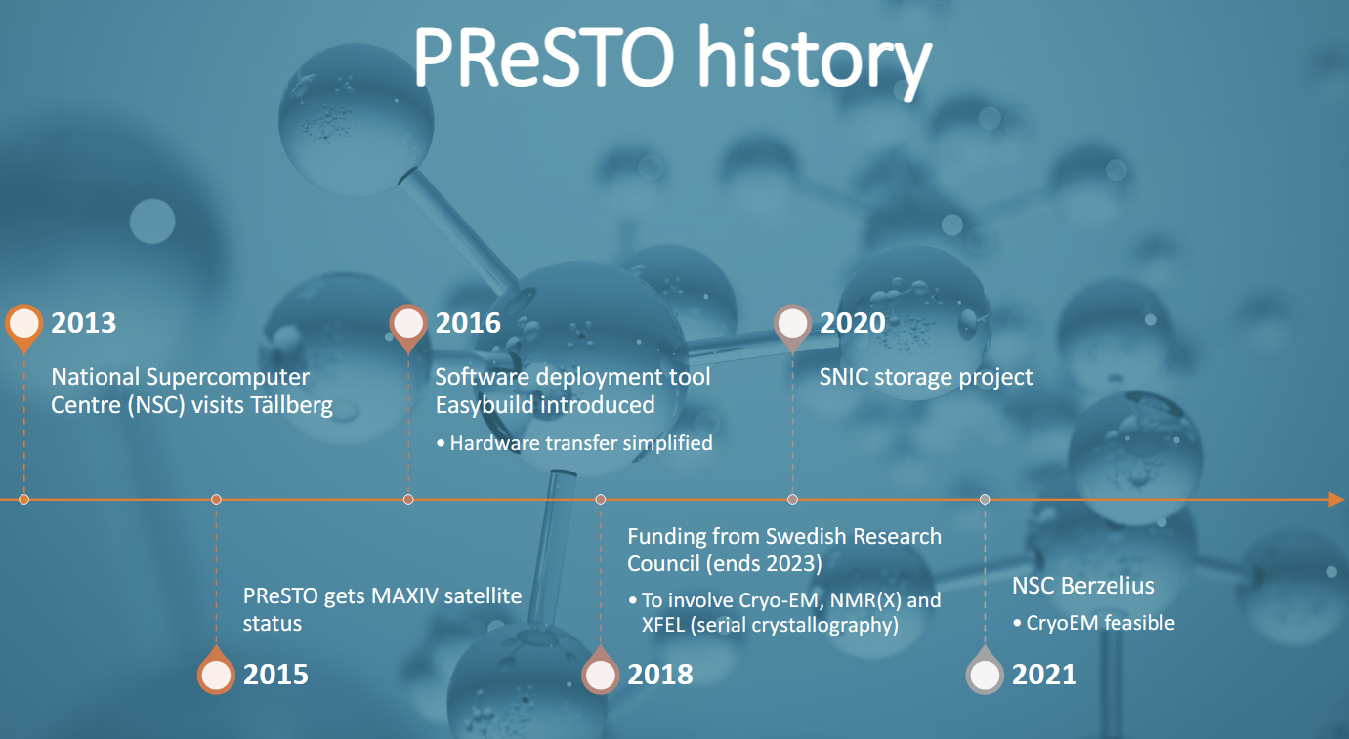
Scientific fields adopt new techniques
PReSTO – structural biology software in high performance compute environment, Integrative Structural Biology Course, 22 Aug 2022, Martin Moche
2024
Workshop at Berzelius SciLifeLab supercomputer
2022
PReSTO launches 3 training courses
in Struct. Bio.
2023
Lund Uni. adds 8,000 AMD cores w/ 256 GB RAM, 12xA100+ 12xA40

Slide 11


Scientific disciplines are joining together
History, SBGrid, Accessed - 20/07/2025
Dr Piotr Sliz runs X-ray xtal code for Harvard, Yale, and Boston Children’s Hospital (SGI IRIX, Linux)
SBGrid paper Joining with XSEDE
SBGrid expands 37 labs & 14 institutes
Joining forces with European infrastructure
COVID remote seminars & recordings
2000
2002
2006
2008
2013
2016
2020
2023
2025
EM & NMR code added
Workshops, workshops, workshops ….
BioGrids launched at Harvard Medical School
Quo vadis structural biology? 300 people participate

Slide 12

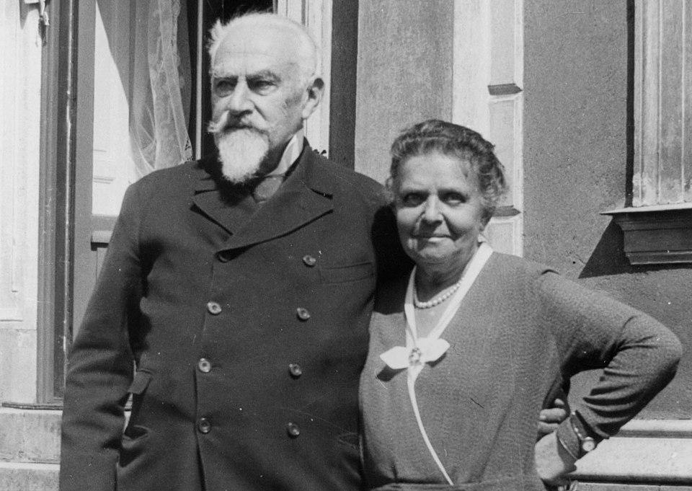
Even countries are joining together
cryoNET, Accessed - 20/07/2025
A Nordic pyramid, The Economist, 10th March 2016
2018
20[19|20|21|22]
1st cryoNet Symposium
2nd, 3rd, 4th, 5th, annual cryoNet Symposium
2023,2024
2023,2024
6th, 7th Symposium
1st, 2nd course on advanced CryoEM
2025
Så / Hvad så? cryoNET
Knut & Alice Wallberg (1917) of Wallberg business family Ericsson, Electrolux, AstraZeneca, SAS Airlines… (i.e. loaded) in 1970s influenced 40% of stock market & workforce [1.]
8th Symposium, 3rd course

Slide 13
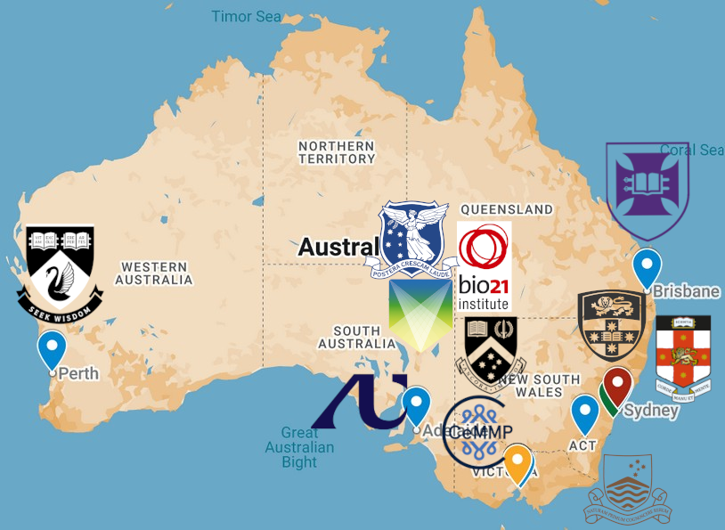

Where ya goin’ Australia?

Slide 14
Questions/Discussion
Facility: unsw.edu.au/research/facilities-and-infrastructure/find-a-facility/sbf​
Web port: cryosparc.analytical.unsw.edu.au​
My site: keiran-rowell.github.io/​ Staff (thanks!): Nathan & Josh (Computational Systems Officers)
Collaborators: Drs Hasti Iranmanesh & Daniel Luque, Peilie Yang

